Slide 1
Legal Debates in Islamic Financial Instruments
Romi Adetio Setiawan
PhD Candidate at School of Law Western Sydney University, and an Awardee of Ministry of Religious Affairs of Indonesia Scholarship.
Delivered on 29 July 2022 at Postgraduate Islamic Studies Networks, Western Sydney University, Australia.

Slide 2
Introduction
Islamic Financial Instruments – Cost roughly the same as conventional banks but they are sharia-compliant.
Islamic Banking and Finance usually associated with ethical business.
Sharia compliance gives rise to unique risks for Islamic banks not faced by conventional banks

Slide 3
Free of Interest System
Free of interest (riba); free from excessive uncertainty and (potentially deceptive) ambiguity (gharar); free from speculation and gambling (maysir); and free from falsehood (bathil)
The purpose of these prohibitions is referenced in the Qur’anic verse ‘And if someone is in hardship, then [let there be] postponement until [a time of] eases. But if you give [from your right as] charity, then it is better for you, if you only knew.’ (Qur’an 2:280)

Slide 4
Opinion on Riba
Riba – lit. Usury or Elevation (Interest)
Muhammadiyah scholars prohibit bank interest, where the illat (cause) of riba is the existence of exploitation
NU scholars argue riba as prohibited, allowed with exception, syubhat (doubt)
MUI & Majma’ al Fiqh al Islami defined riba as additional money out of the principal amount in loan (based on Qur’an 2:279)

Slide 5
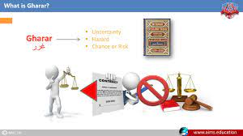
Gharar
Gharar lit. danger or deception
In modern banking system – customer given the choice “take it or leave it”

Slide 6
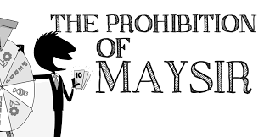
Maysir (Speculation or gambling)
Earning money by way of gambling, from mere chance or speculation, where the activity contains element of gharar – to win or lose sum of money.
Such as in conventional insurance, where the policy are invested for profit but not distributed to policy holders, only given when they claimed, what if the claims are never met.

Slide 7
Criticisms of Islamic Financial Instruments
Islamic products are very similar to conventional products
Abdullah Saeed “these interest-based transactions are just being renamed “
Dusuki, Abozaid, Choudury and Khan, “Islamic finance have gone too far from the main purpose of sharia”

Slide 8
Modern Stratagem
Modern versions of tradition stratagem – bridge gap between classical and contemporary financial practices
(E.g Using interest as their benchmark to calculate profit)
Scholars found it by marrying two or more traditional contracts in one business activity (uqud al-murakkabah) (Mihajat 2014, Yunus et al 2016)

Slide 9
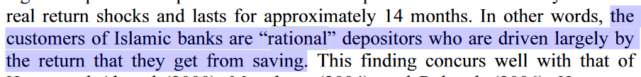
Customers in Indonesia
Kasri and Kassim stated:
How sharia is Islamic bank in Indonesia? How the IB maintains its reputation?

Slide 10
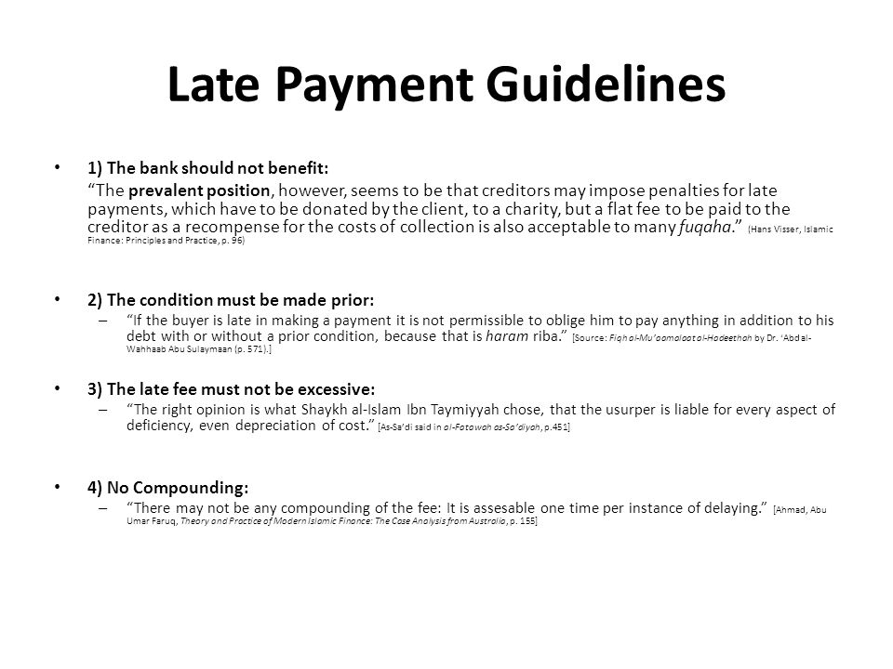


Slide 11
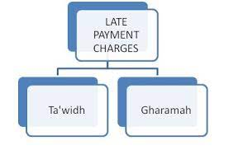
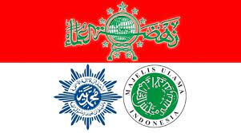
Ta’widh and Gharamah
Imposition of Fee due to late or failure of payment is RIBA
=
Social Needs + Ethical banks
Causes Banks face the greater liquidity risk and losses of profit.
Compensation
Penalty

Slide 12

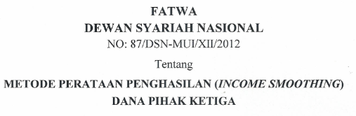
Controversy on Rate of Profit Returns
Profit return should be competitive to conventional rivals
PER or IRR is annovative solution based on maslahah

Slide 13
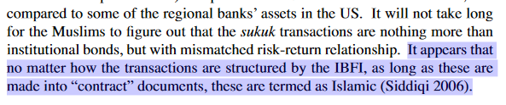
The Critics on PLS
Is profit return in IB is nearly identical to or closely aligned to interest rate in CB?
‘The predominance of interest-based financing is still the norm in Islamic Banks, the main difference being that now it is no longer explicitly identified as interest-based finance and that the business is no longer dominated by non-Muslims.’ Khan

Slide 14

Mudharabah-based Financing; ‘the Jewel in the Crown’
The critics of collateral in mudharabah among Indonesian scholars
Azhar criticises, taking collateral will invalid the mudharabah contract and will be same as pawnbroker
No Banks will never accept the risk of losses without security of collateral
BI Regulation No 7/46/PBI/2005 on the Deposit and Financing of Funds for Banking Conducting Business Based on Sharia Principles
MUI fatwa No 7/DSN/MUI/IV/2000 on Mudharabah financing

Slide 15
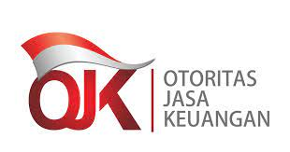

Criticism on Predetermined Return in Mudharabah
There’s a contentious issue where customer have to pay back the profit return more than its owned ratio.
MUI - the profit sharing ratio should not be linked with the future prediction.
FSA - it is not allowed to recognise income based on projected value
Mudharabah less competitive – need to be modified

Slide 16
Criticism on Mark-up-based Murabahah
Murabahah akin to lines interest-based contract – ownership held by the bank till debt has been paid (Azhar, Sjahdeini)
IB do the mark up before owning the good (ba’i ma’dhum) hadith narrated by Hakim bin Hizam (Sunan Abu Daud No 3503)
Murabahah in contemporary bank is combined with other contracts (al-uqud al-murakkabah) – murabahah, waad, wakkalah (Rida, Othmane, Boujemaa)
Interest rate is exchange of money VS murabahah is gained via trade in real goods = time dependent

Slide 17
Using Conventional Interest Rates
How, basically?
(1) Mark up cost in murabahah
(2) Commodities fluctuates over the time which exposed bank to (price risk, credit risk, market risk)
(3) Bank is prohibited from charging more to the client when commodity price fluctuate high
Thus interest-rate benchmarking is applied in the entire IB instruments.
Classical Finance
A Modern Islamic Finance
Risk Mitigation
?

Slide 18
Implications
Almost 50% said IB profit is less competitive (Sudarsono, Tumewang & Kholid, 2021)
Classical PLS is riskier on the asset (investment) side of the ledger
Without interest calculation in IB the role of BI to monitor monetary policy would be unclear. (affecting- currency exchange rate, net exports, inflation, unemployment)
Classical PLS is risky
BI regulates interest rates to meet International market
IB Stable rate of returns + Competitive (innovated) vs CB products

Slide 19
In Sum
Many significant problems and challenges remain
Islamic Financial Instruments (‘IFI’) is still a subject of dispute, esp. for debate on innovative; what is religiously permissible or forbidden?
Vast of sceptics’ perception.
The shift in religious preference and customer’s commitment
Take as spurs to improvement
The goals of future growth of IB depend on innovation IFI (for market demand, liquidity, risk management, interbank money market)

Slide 20
References
Qur’an 2:279-280
Abdullah Saeed, Islamic Banking and Interest: a Study of the Prohibition of Riba and Its Contemporary Interpretation (E.J. Brill, 2nd ed, 1999) 95
Ausaf Ahmad, 'Contemporary practices of Islamic financing techniques' (1994) 2(1) Islamic Economic Studies
Mondher Bellalah and Omar Masood, Islamic Banking and Finance (Cambridge Scholars Publisher, 2013)
Masudul Alam Choudhury, 'Islamic Economics and Finance: A Fiasco' (2008) 20(1) The Middle East Business and Economic Review 38
Asyraf Wajdi Dusuki and Abdulazeem Abozaid, 'A Critical Appraisal on the Challenges of Realizing Maqasid al-Shari'ah in Islamic Banking and Finance' (2007) 15(2) IIUM Journal of Economics and Management 143
Feisal Khan, 'How 'Islamic' is Islamic Banking?' (2010) 76(3) Journal of Economic Behaviour & Organization 80
Rahmatina A Kasri and Salina Hj. Kassim, 'Empirical Determinants of Saving in the Islamic Banks: Evidence from Indonesia' (2009) 22(2) J.KAU: Islamic Econ 3, 16
Fatwa DSN MUI https://dsnmui.or.id/kategori/fatwa/
BI Regulation No 7/46/PBI/2005 on the Deposit and Financing of Funds for Banking Conducting Business Based on Sharia Principles
SUDARSONO, H., TUMEWANG, Y. K., & KHOLID, M. N. (2021). Customer Adoption of Islamic Banking Services: Empirical Evidence from Indonesia. The Journal of Asian Finance, Economics and Business, 8(3), 1193-1
http://www.siicex.gob.pe/siicex/documentosportal/alertas/documento/doc/661967144radC8C6E.pdf

